Slide 1
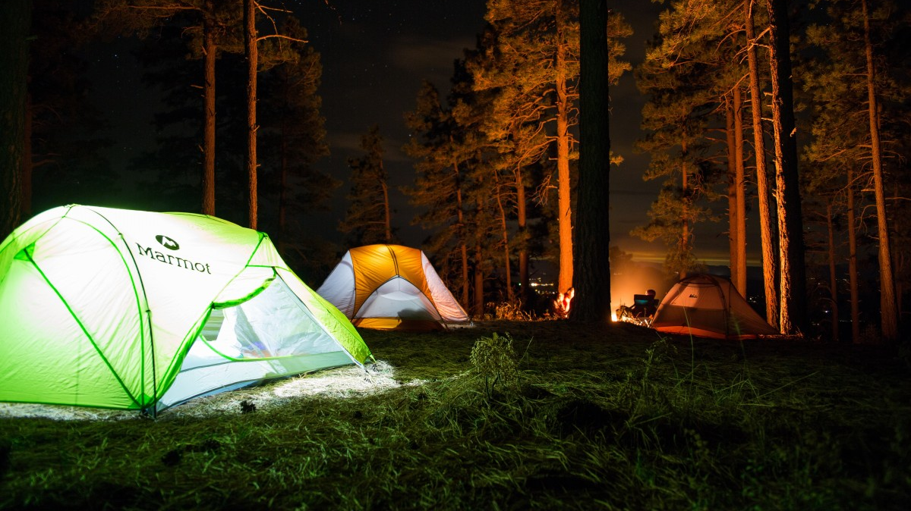

TsaDiree®
Lazanas D. Tsalmpouris A.
Notes:
Add logo

Slide 2
What we did
In our assignment, we were tasked to create a user-friendly “Smart Camping” application.
We made a Hierarchical Task Analysis, designed some prototypes and evaluated them using Norman’s model.
Finally, we wrote all necessary documentation.

Slide 3
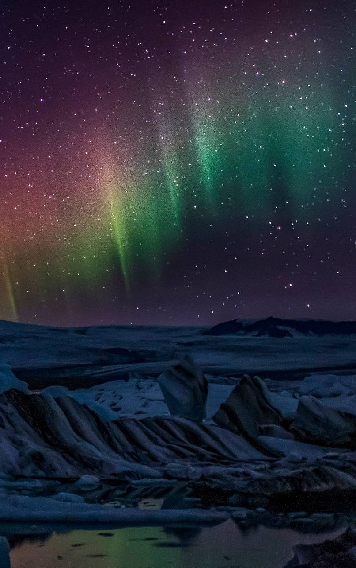
Product overview

Slide 4
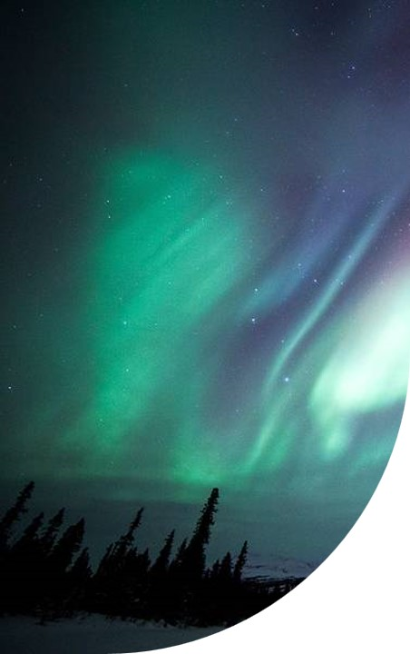
Product overview
First beautifully designed product that's both stylish and functional

Slide 5
Problem we solve
Complicated software: few, if any, products on the market help customers like we do
Customers: 66% of Gen Z people are going frenzy about this new trend of eco friendly smart camping lifestyle
Financials: Gen Z are most of our client base
Costs: a lot of people are not qualified to use low level software and hardware tools to set up smart camps by themselves, so they are forced to pay to qualified technicians
Usability: customers want something easy to use that helps make their life easier

Slide 6
Our competition
Our product has no competition whatsoever, and its free to use and is open source!

Slide 7
Interface Overview
Smart Camp made easy

Slide 8
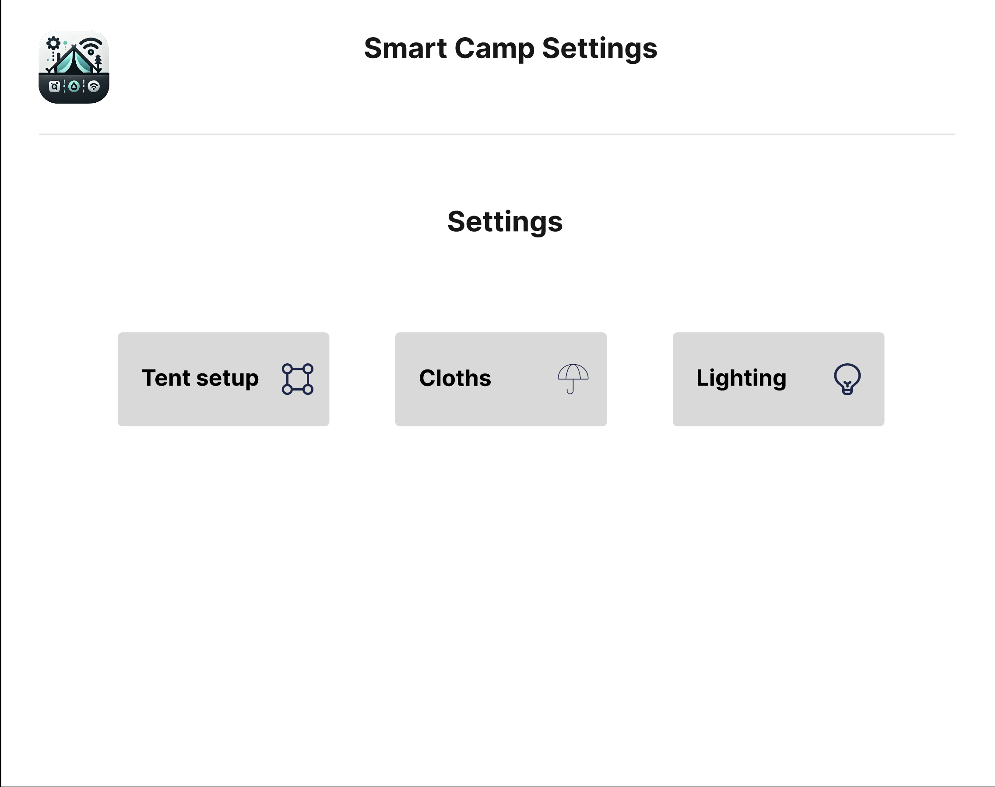
Main Screen
Very simple main screen
Three main options for:
Tent Setup
Cloths
Lighting

Slide 9
Tent Setup
Choosing location
Poles settings

Slide 10
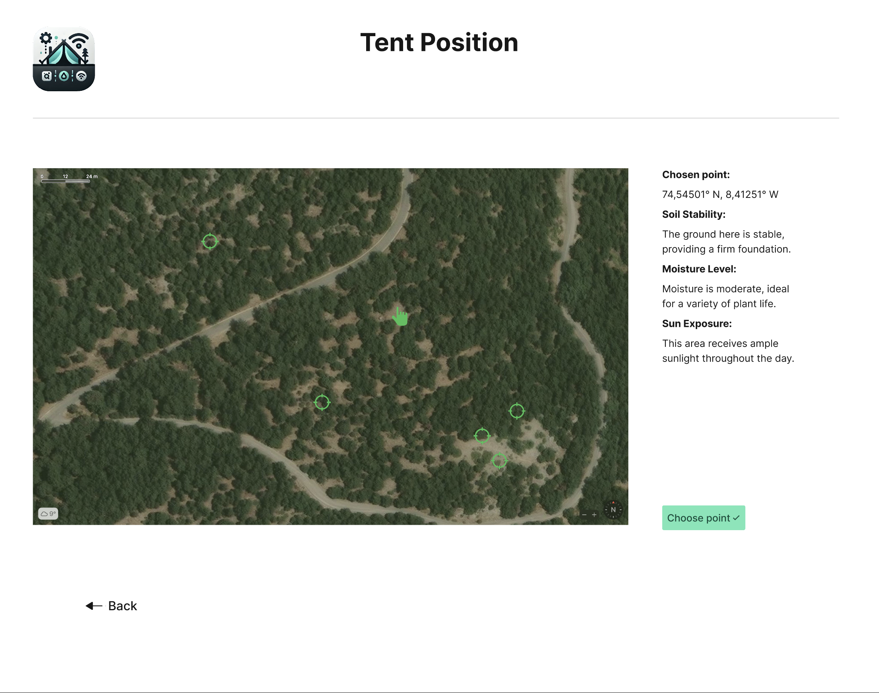
Tent Setup Interface - Position
Allows User to choose location in an intuitive, interactive way
Provides information about point that is being hovered over
Shows suggestions for optimal tent positions

Slide 11
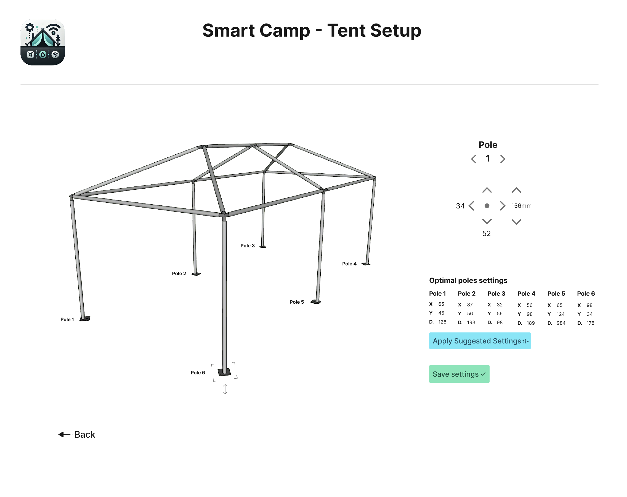
Tent Setup Interface - Setup
Provides tools for accurate setting of each pole
Shows suggestions for optimal settings

Slide 12
Cloths Settings
Precise cloths installation

Slide 13
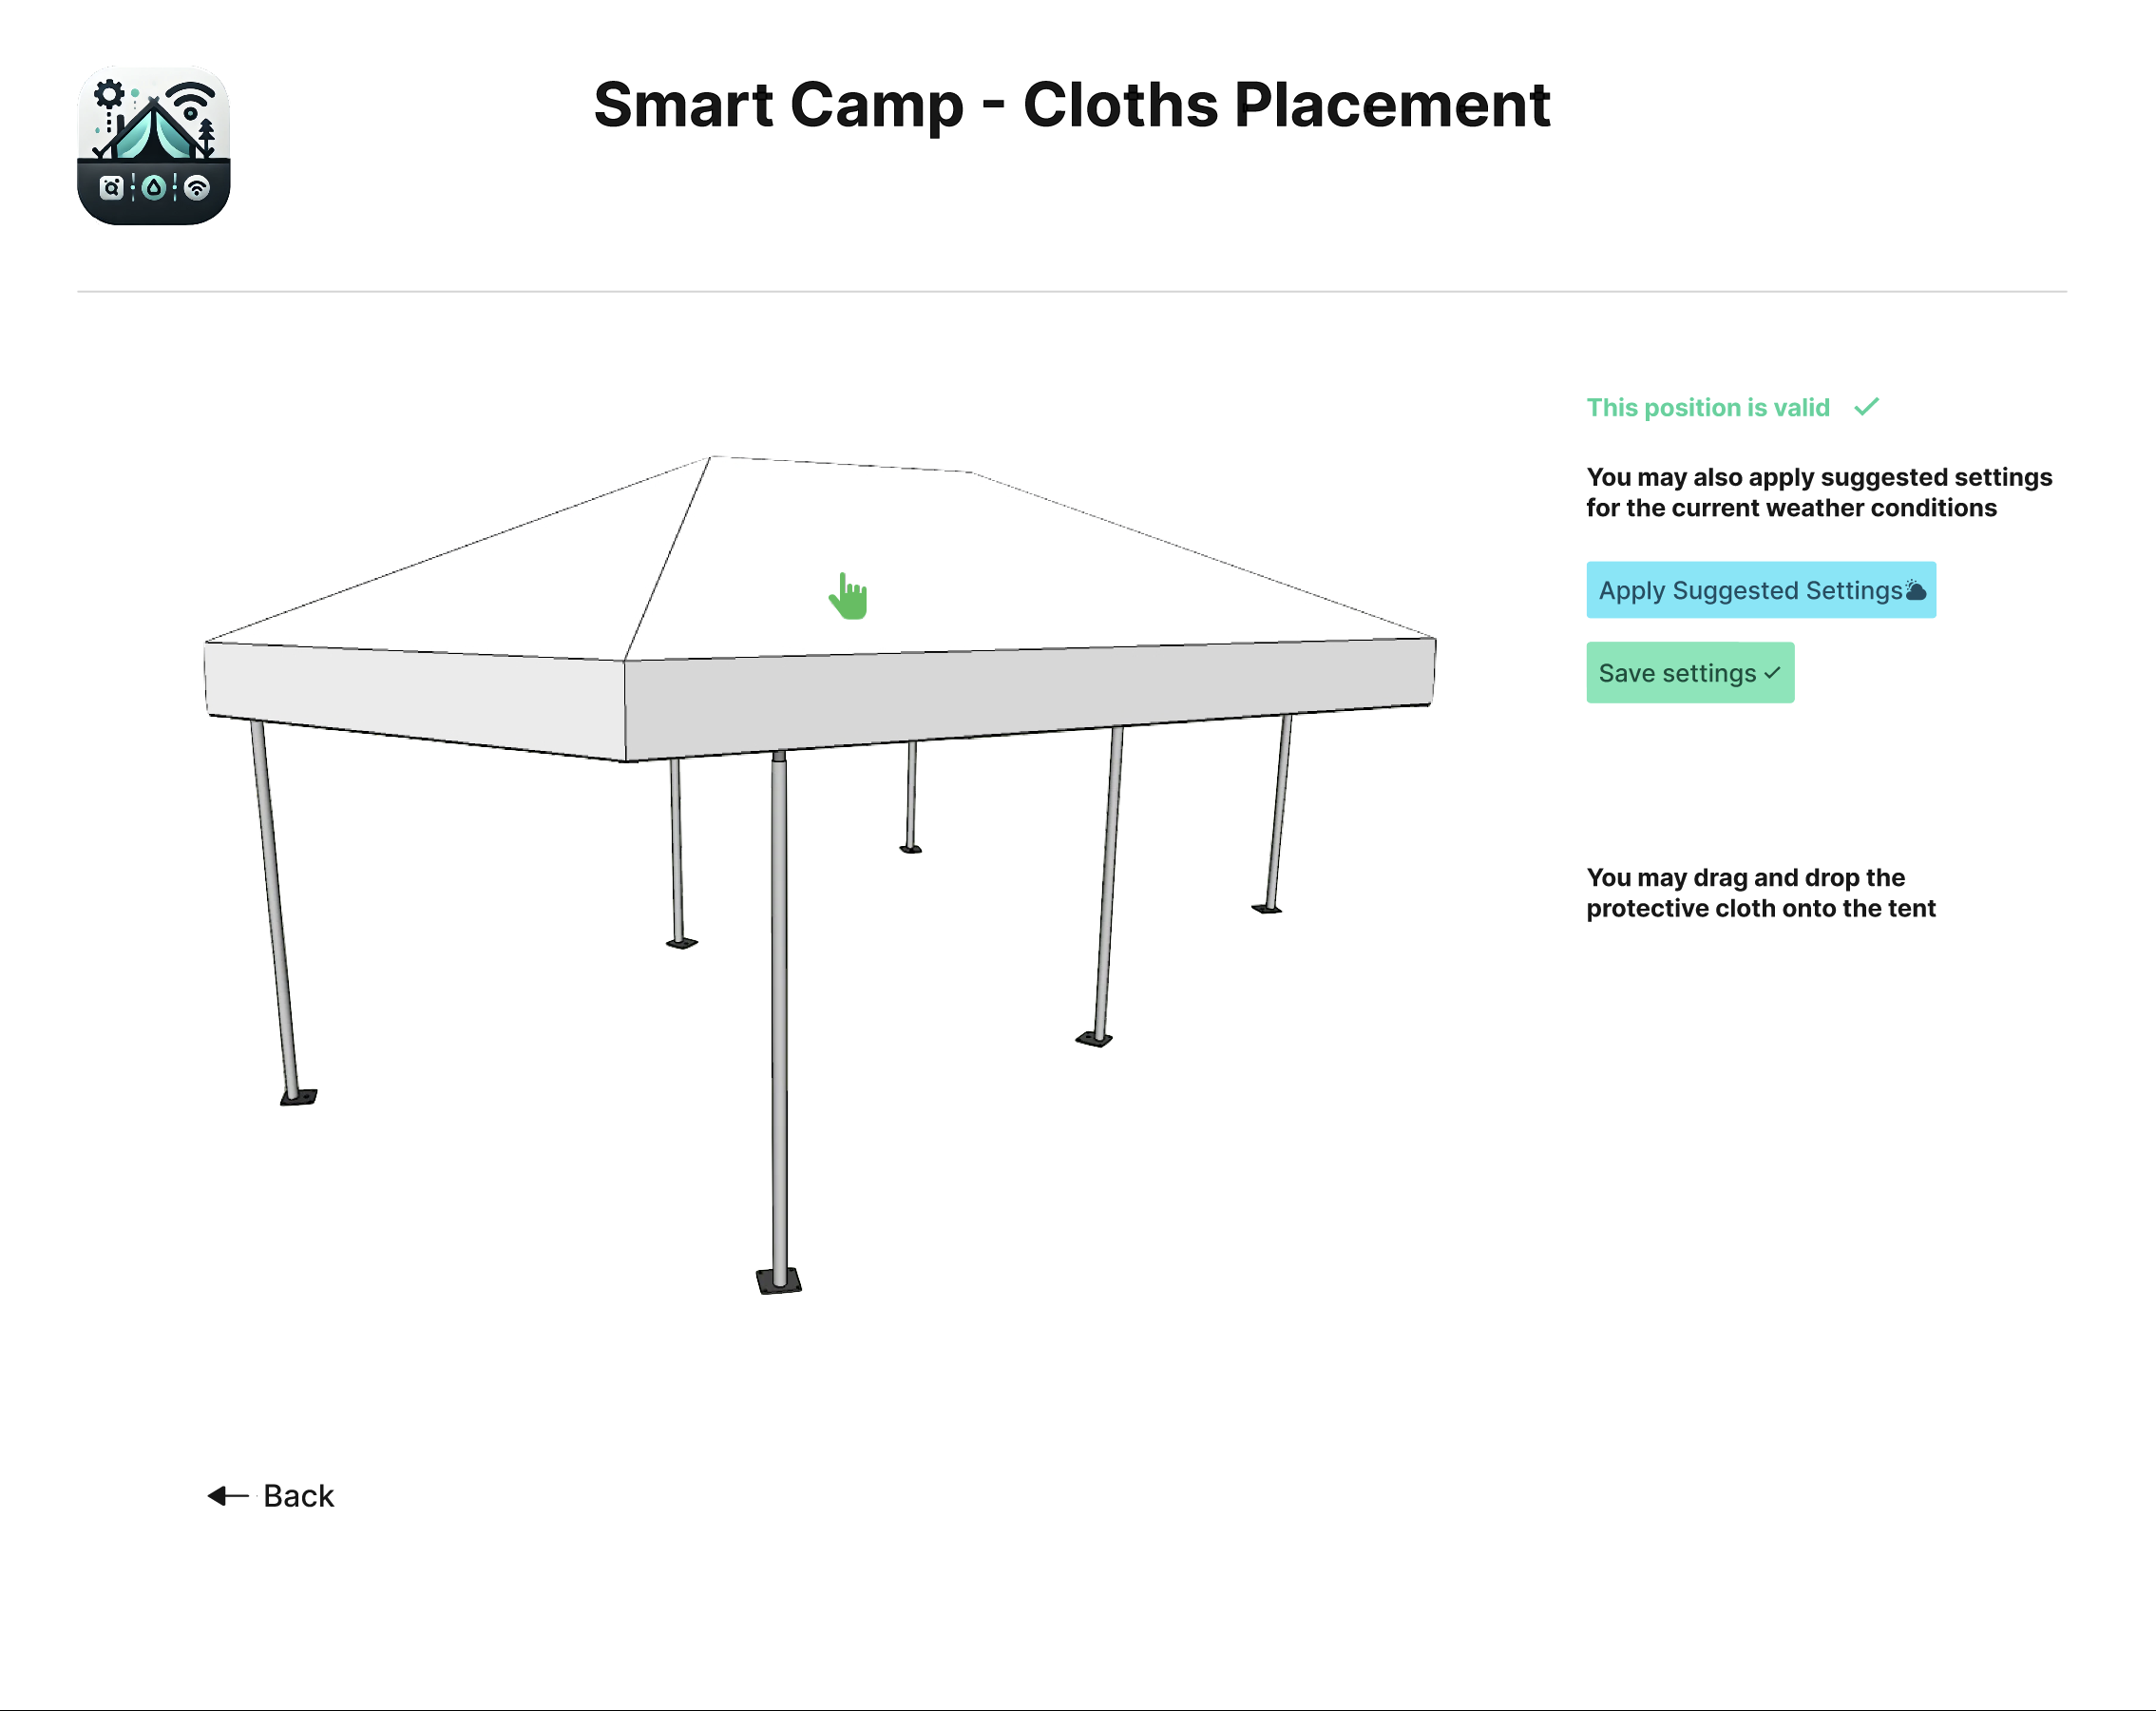
Cloths Placement
Provides tools for accurate setting of each pole
Shows suggestions for optimal settings
Easy drag and drop interface and real-time preview
Message showing whether or not current setting is optimal

Slide 14
Lighting Settings
Settings for ambient light at nights
Light effects for special occasions (birthday, wedding, funeral)

Slide 15
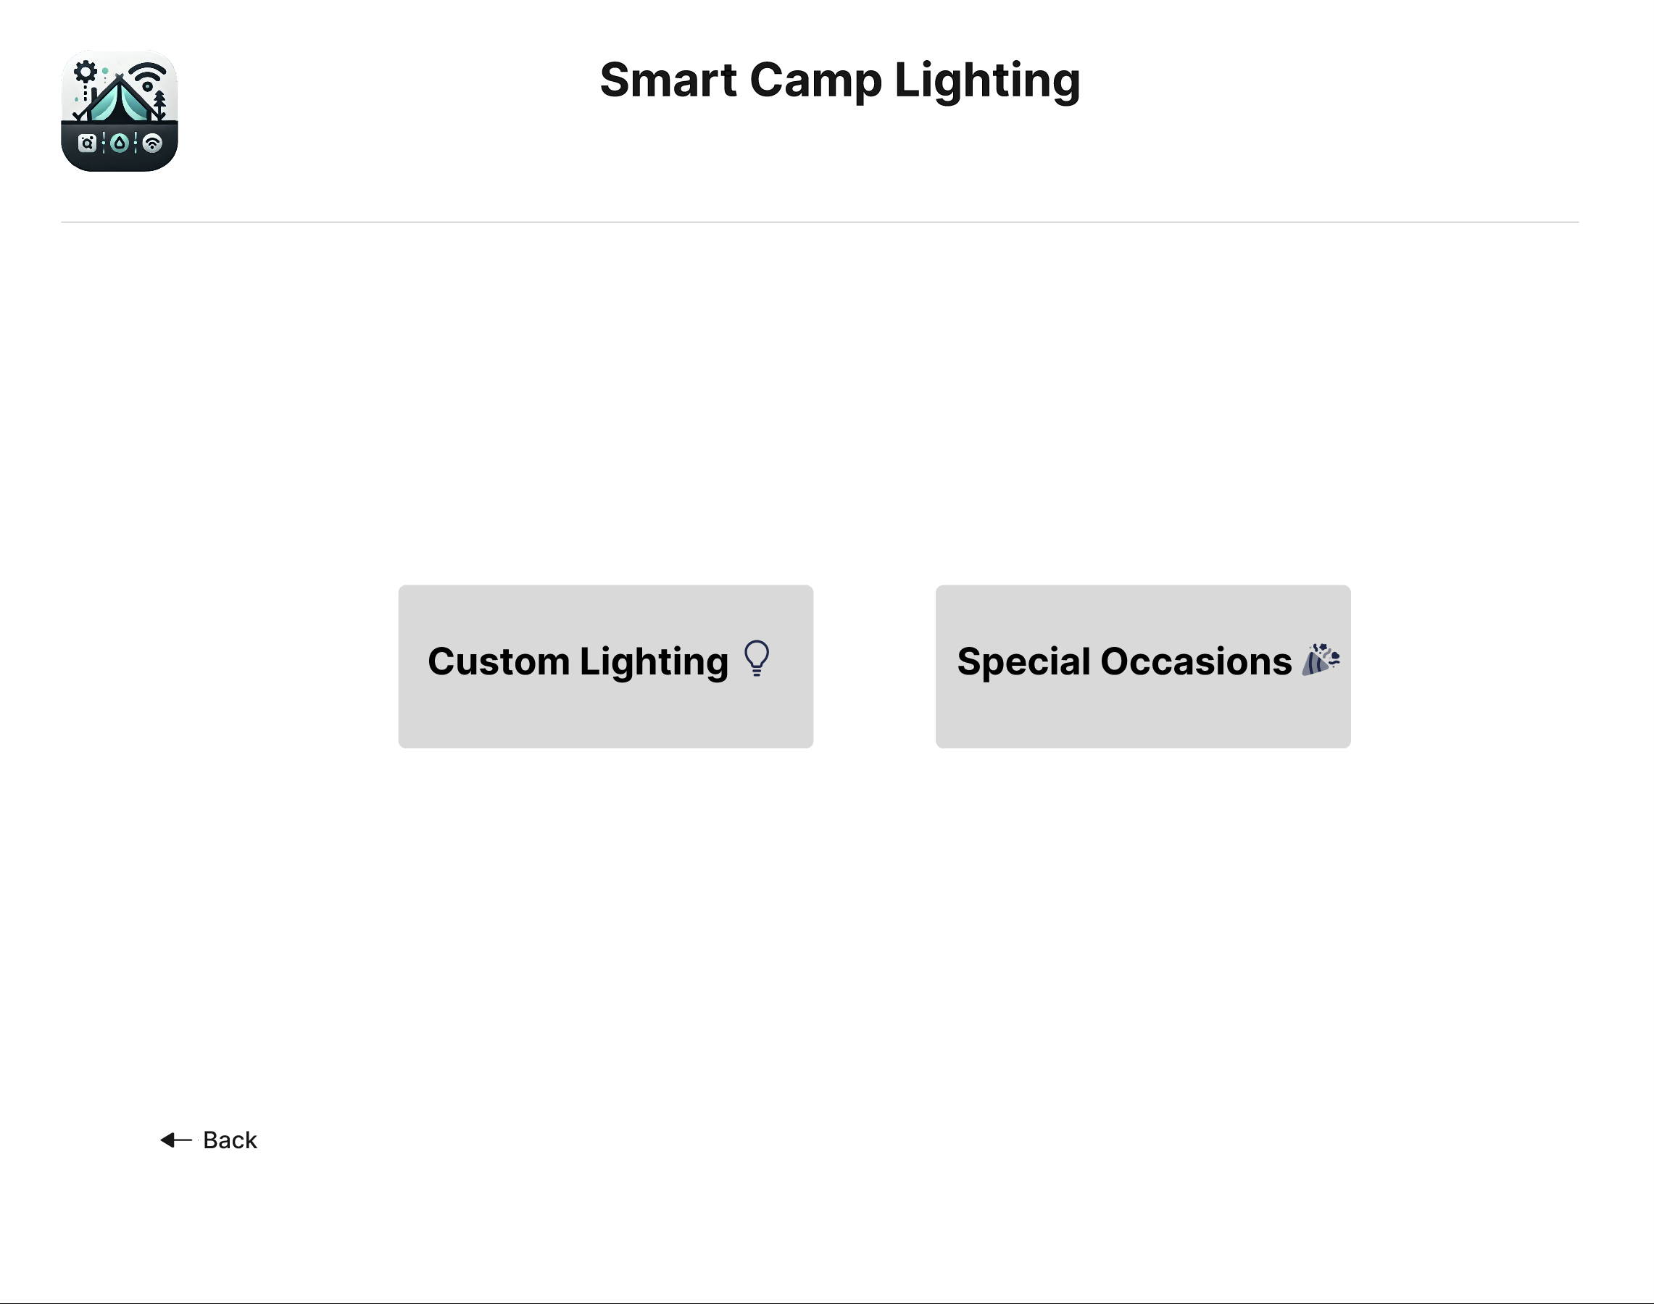
Lighting Settings - Main Menu
Custom Lighting
Special occasions

Slide 16
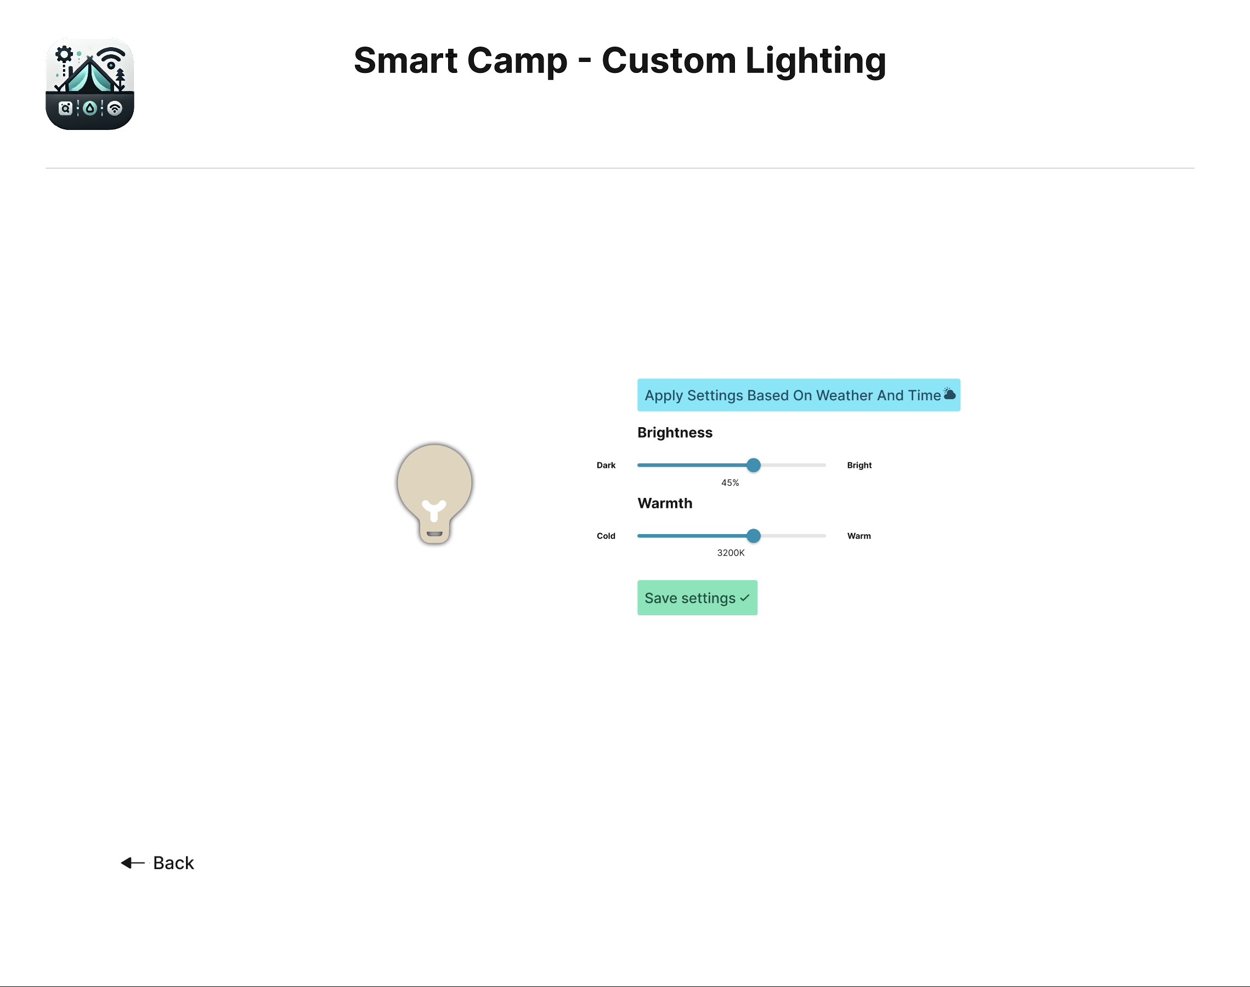
Lighting Settings – Custom Lighting
AI Powered suggestion of settings based on current weather, time and user’s mood (through NeuraLink’s in-brain chip)
Shows a preview of applied setting via interactive AI – powered animated light bulb

Slide 17
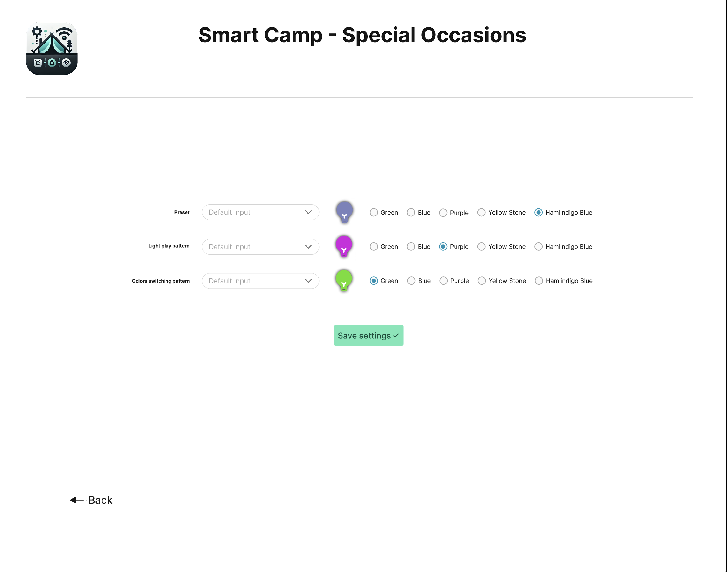
Lighting Settings – Special Occasions
User may choose one of the pre-made lighting settings for predefined types of events (Wedding, Generic Celebration, Funeral)
Settings are shown up on animated lightbulbs
User may choose different colors or same color, such as Green, Purple, Hamlindigo Blue

Slide 18
Implementation

Slide 19
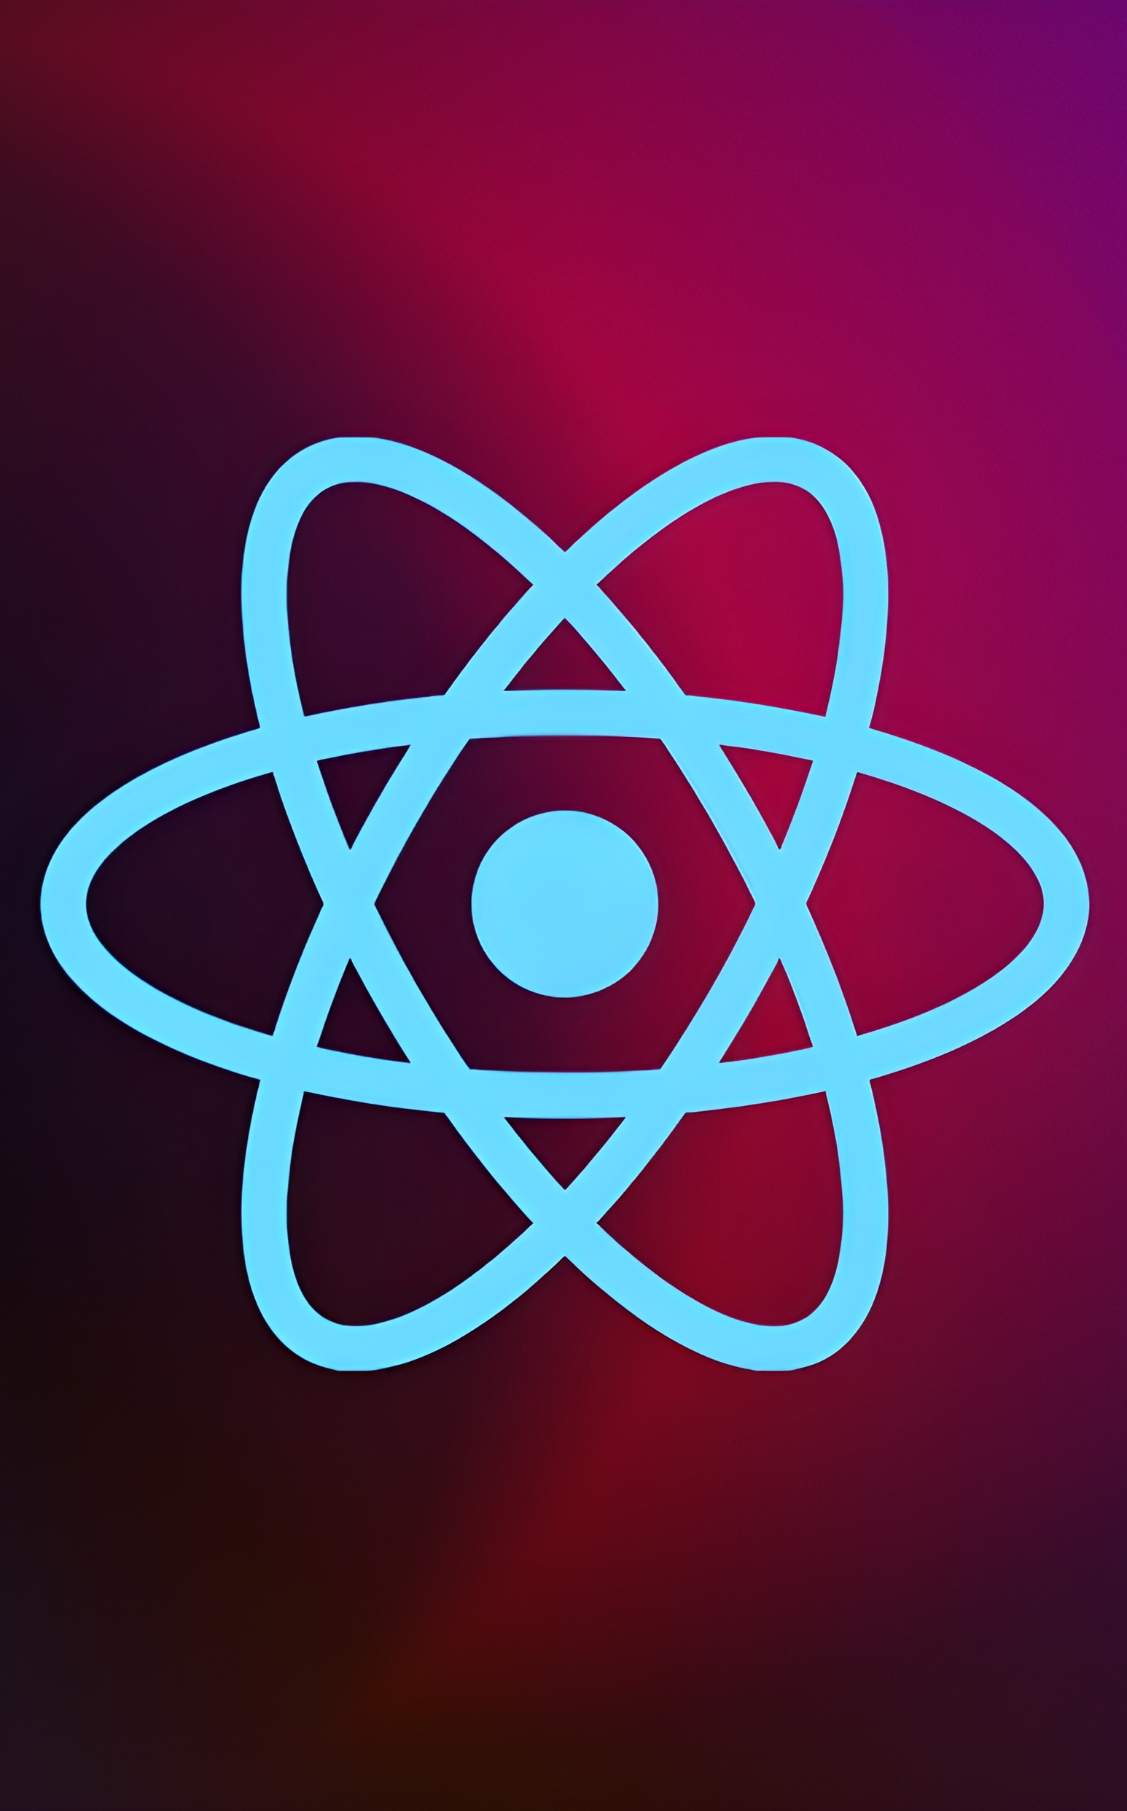
Why React Native?
React Native is top – notch technology used by Facebook, Microsoft, Netflix.
Shared codebase among platforms (Windows, macOS), no need to write for each platform.
Good performance, ease of development.
Web developers with little preparation can start writing native applications.

Slide 20
Market overview
Opportunity to build
Fully inclusive market
Total addressable market
Freedom to invent
Selectively inclusive market
Serviceable available market
 | Clients | Orders | Gross revenue | Net revenue
20XX | 10 | 1100 | $10,000 | $7,000
20XX | 20 | 200 | $20,000 | $16,000
20XX | 30 | 300 | $30,000 | $25,000
20XX | 40 | 400 | $40,000 | $30,000

Slide 21
Product overview
Our product makes consumer lives easier, and no other product on the market offers the same features
Gen Z (18-25 years old)
Reduce expenses for replacement products
Simple design that gives customers the targeted information they need
Close the gap
Target audience
Cost savings
Easy to use

Slide 22
Financials
 | Year 1 | Year 2 | Year 3
Income
Users | 50,000 | 400,000 | 1,600,000
Sales | 500,000 | 4,000,000 | 16,000,000
Average price per sale | 75 | 80 | 90
Revenue @ 15% | 5,625,000 | 48,000,000 | 216,000,000
Gross profit | 5,625,000 | 48,000,000 | 216,000,000

Slide 23
Thank you! ΚΑΙ ΧΑΡΗ ΣΑΣ ΚΑΝΑΜΕ!
Antonis Tsalmpouris p22272 Dimitrios Lazanas p22082
dimitris@mynavlo.com

